Slide 1

COMPUTER SCIENCE CLUB
Intro To CCC and DMOJ
Tony

Slide 2
CS Club
CCC

Slide 3
CCC
Canadian Computing Competition
Run by University of Waterloo
Held in February, online
We host it every year
Ask Mr. Seidel and Mr. Kowalczewski for questions about registration
Two levels, Junior and Senior
5 problems each
J5 ~= to S2
Visit https://cccgrader.com/ for more information

Slide 4
CS Club
DMOJ

Slide 5
DMOJ
DMOJ: Modern Online Judge. (yes, its actual name)
Host lots of competitive programming questions
Various competitions held by its users
DMOJ.ca
Supports various languages

Slide 6
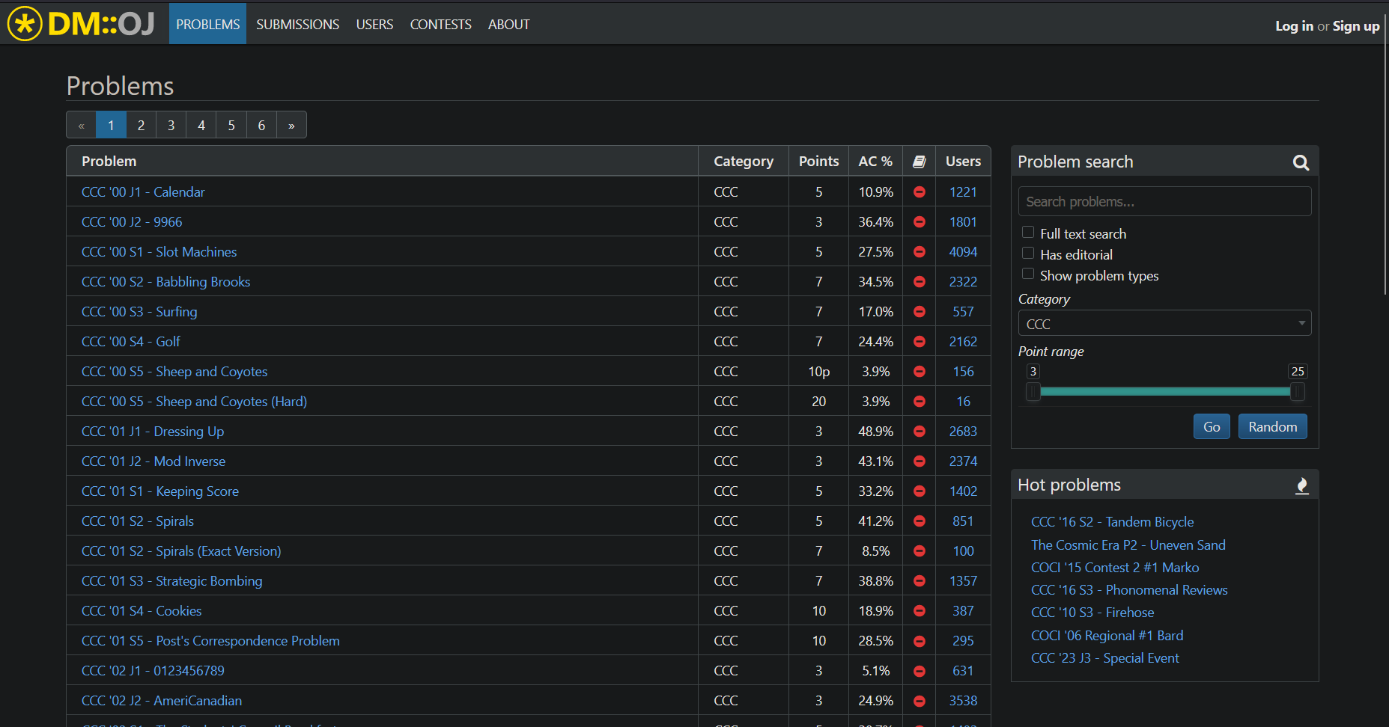
DMOJ (a quick guide)
Make an account
Click on problems
Filter to CCC
Check out some of the problems!

Slide 7
DMOJ (a quick guide)
Has sample inputs and outputs
General problem is described here
Submit solution button
Box to put code in
Can write program in here, but not recommended
Various languages at the bottom
Double check that you can use them on the CCC!

Slide 8
DMOJ Activity
Beginners:
https://dmoj.ca/problem/ccc23j1
Intermediate
https://dmoj.ca/problem/ccc22j3
Advanced:
Any senior question of your choosing

Slide 9
More Questions
Beginners:
https://dmoj.ca/problem/ccc13s1
Intermediate
https://dmoj.ca/problem/ccc19s1
Advanced:
Any senior question of your choosing

Slide 10
THANK YOU!

